Slide 1

Software Testing
Notes:
Software testing includes the sets of activities necessary to discover bugs or defects in a software program that might determine a software to crush or might cause incorrect behaviour

Slide 2
Overview
What is testing and why is it important
Testing Framework
CUnit
Examples
Notes:
2

Slide 3

Testing can only show the presence of errors and not their absence
E. Dijkstra
Notes:
Testing cannot demonstrate that the software is free of defects or that it will behave as specified in every circumstance
It is always possible that a test that you overlooked could discover further problems with the system

Slide 4
Difficulties of Testing
Perception by some developers and managers:
Testing is seen as a novice's job.
Assigned to the least experienced team members.
Done as an afterthought (if at all).
"My code is good; it won't have bugs. I don't need to test it."
"I'll just find the bugs by running the client program."
Limitations of what testing can show you:
It is impossible to completely test a system.
Testing does not always directly reveal the actual bugs in the code.
Testing does not prove the absence of errors in software.

Slide 5
Three Stages of Testing
Development Testing:
System is tested during development to discover bugs and defects
Release Testing:
A separate team tests a complete version of the software system before its release
Check that the system meets the stakeholders’ requirements
User Testing (or Beta Testing):
Users test the system in their own environment
Decide whether the software should be accepted or further development is required
Notes:
The output of the architectural design process is an architectural model describing how the system is organised as a set of communicating components

Slide 6
Three Stages of Testing
Development Testing:
System is tested during development to discover bugs and defects
Release Testing:
A separate team tests a complete version of the software system before its release
Check that the system meets the stakeholders’ requirements
User Testing (or Beta Testing)
Users test the system in their own environment
Decide whether the software should be accepted or further development is required

Slide 7
Development Testing
Aimed to discover bugs in the software
Interleaved with debugging
Carried out by the software programmers
Three levels of granularity:
Unit testing
Individual program units are tested.
Testing functionality of methods
Component testing
Testing component interfaces
System testing
Some or all the components in a system are integrated and the system is tested as a whole
Testing components interactions
Notes:
The output of the architectural design process is an architectural model describing how the system is organised as a set of communicating components

Slide 8
Development Testing
Aimed to discover bugs in the software
Interleaved with debugging
Carried out by the software programmers
Three levels of granularity:
Unit testing
Individual program units are tested.
Testing functionality of methods
Component testing
Testing component interfaces
System testing
Some or all the components in a system are integrated and the system is tested as a whole
Testing components interactions
Notes:
Cover all the features of a software module
Operations
Set and check value of variables of a module

Slide 9
Automation
Tests are encoded in a program that is run each time the system under development is to be tested
Very important for regression testing!

Slide 10
Automating Test Cases Execution
Unit-Testing Framework
A unit-testing framework is a software tool for writing and running unit tests
Provides reusable test functionality which:
Is easier to use
Is standardized
Enables automatic execution (important for regressions tests)
CUnit (https://sourceforge.net/projects/cunit/)
Notes:
The output of the architectural design process is an architectural model describing how the system is organised as a set of communicating components

Slide 11
Why Unit-Testing Framework
Lightweight tool that uses the same language and development environment as the programmer
Offers an easy, systematic, and comprehensive way of organizing and executing tests:
It is practical to collect and re-use test cases
Automatic Regression Testing
Test report generation
Notes:
The output of the architectural design process is an architectural model describing how the system is organised as a set of communicating components

Slide 12
CUnit
Notes:
The output of the architectural design process is an architectural model describing how the system is organised as a set of communicating components

Slide 13
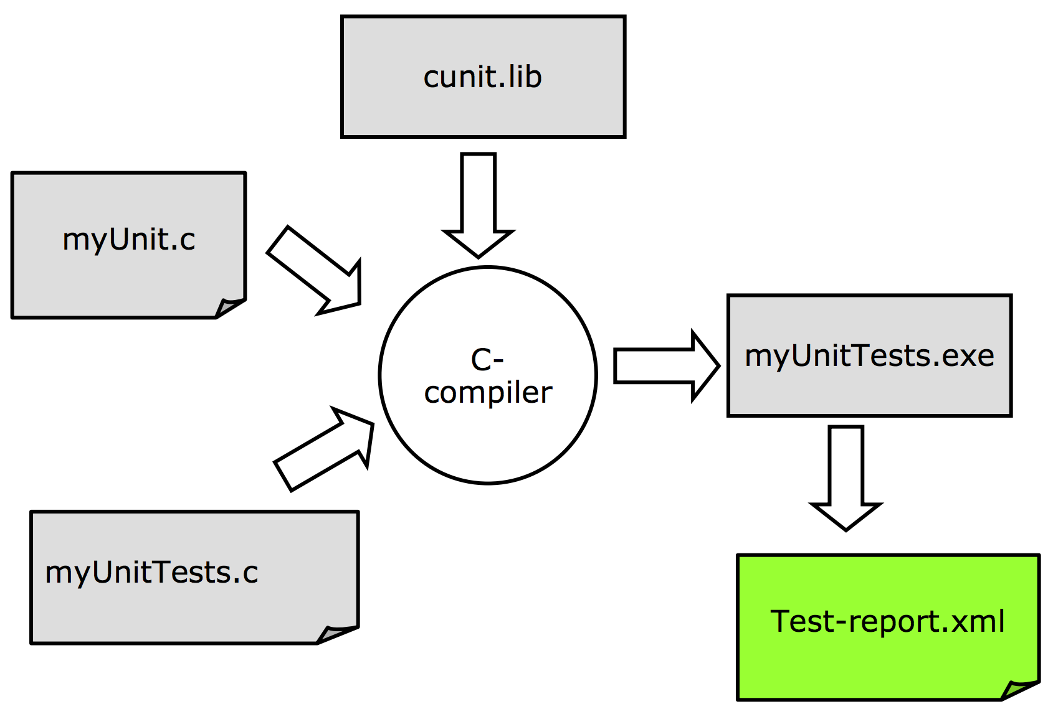
Basic Use of CUnit Framework

Slide 14
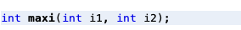
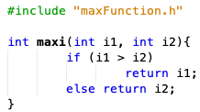
Module to be tested: maxFunction.c
maxFunction.h
maxFunction.c
Returns the greatest between 2 integers i1 and i2
Notes:
The output of the architectural design process is an architectural model describing how the system is organised as a set of communicating components

Slide 15
Main Concepts in a Unit Test
Assertions
Boolean expressions that compare expected and actual results
The basic and smallest building-block
Test Case
A composition of concrete test procedures
May contain several assertions and test for several test objectives
E.g., all test of a particular function
Test Suite
Collection of related test cases
Can be executed automatically in a single command
Notes:
The output of the architectural design process is an architectural model describing how the system is organised as a set of communicating components

Slide 16
CUnit Assertions
CUnit Assertion | Meaning
CU_ASSERT(int expression) | Checks that expression is TRUE (non-zero)
CU_ASSERT_TRUE(value) | Checks that value is TRUE (non-zero)
CU_ASSERT_FALSE(value) | Checks that value is FALSE (zero)
CU_ASSERT_EQUAL(actual, expected) | Checks that actual == expected
CU_ASSERT_NOT_EQUAL(actual, expected) | Checks that actual != expected
CU_ASSERT_PTR_EQUAL(actual, expected) | Checks that pointers actual == expected
CU_ASSERT_PTR_NOT_EQUAL(actual, expected) | Checks that pointers actual != expected
CU_ASSERT_PTR_NOT_NULL(value) | Checks that pointer value != NULL
CU_ASSERT_DOUBLE_EQUAL(actual, expected) | Checks that doubles actual and expected are equivalent
CU_ASSERT_DOUBLE_NOT_EQUAL(actual, expected) | Checks that doubles actual and expected are not equivalent
http://cunit.sourceforge.net/doc/writing_tests.html
Notes:
The output of the architectural design process is an architectural model describing how the system is organised as a set of communicating components

Slide 17
Module Implementing the tests: test.c
#include <stdio.h>
#include <stdlib.h>
#include "maxFunction.h"
#include <CUnit/CUnit.h>
#include <CUnit/Basic.h>
void test_maxi(void){
CU_ASSERT(maxi(0,2) == 2);
CU_ASSERT(maxi(0,-2) == 9);
CU_ASSERT(maxi(1,2) == 2);
}
int main() {
CU_initialize_registry();
CU_pSuite suite = CU_add_suite("maxi_test", 0, 0);
CU_add_test(suite, "maxi_fun", test_maxi);
CU_basic_set_mode(CU_BRM_VERBOSE);
CU_basic_run_tests();
CU_cleanup_registry();
return 0;
}
Necessary modules for creating test cases using cunit
Notes:
The output of the architectural design process is an architectural model describing how the system is organised as a set of communicating components

Slide 18
test.c
#include <stdio.h>
#include <stdlib.h>
#include "maxFunction.h"
#include <CUnit/CUnit.h>
#include <CUnit/Basic.h>
void test_maxi(void){
CU_ASSERT(maxi(0,2) == 2);
CU_ASSERT(maxi(0,-2) == 9);
CU_ASSERT(maxi(1,2) == 2);
}
int main() {
CU_initialize_registry();
CU_pSuite suite = CU_add_suite("maxi_test", 0, 0);
CU_add_test(suite, "maxi_fun", test_maxi);
CU_basic_set_mode(CU_BRM_VERBOSE);
CU_basic_run_tests();
CU_cleanup_registry();
return 0;
}
Test case

Slide 19
test.c
#include <stdio.h>
#include <stdlib.h>
#include "maxFunction.h"
#include <CUnit/CUnit.h>
#include <CUnit/Basic.h>
void test_maxi(void){
CU_ASSERT(maxi(0,2) == 2);
CU_ASSERT(maxi(0,-2) == 9);
CU_ASSERT(maxi(1,2) == 2);
}
int main() {
CU_initialize_registry();
CU_pSuite suite = CU_add_suite("maxi_test", 0, 0);
CU_add_test(suite, "maxi_fun", test_maxi);
CU_basic_set_mode(CU_BRM_VERBOSE);
CU_basic_run_tests();
CU_cleanup_registry();
return 0;
}
The test registry is the repository for suites and associated tests.
CUnit maintains an active test registry which is updated when the user adds a suite or test.
The user always has to initialize the registry before use and cleanup afterwards.

Slide 20
test.c
#include <stdio.h>
#include <stdlib.h>
#include "maxFunction.h"
#include <CUnit/CUnit.h>
#include <CUnit/Basic.h>
void test_maxi(void){
CU_ASSERT(maxi(0,2) == 2);
CU_ASSERT(maxi(0,-2) == 9);
CU_ASSERT(maxi(1,2) == 2);
}
int main() {
CU_initialize_registry();
CU_pSuite suite = CU_add_suite("maxi_test", 0, 0);
CU_add_test(suite, "maxi_fun", test_maxi);
CU_basic_set_mode(CU_BRM_VERBOSE);
CU_basic_run_tests();
CU_cleanup_registry();
return 0;
}
Creates a new test collection (suite) having a specified name, initialization function and cleanup function.
The suite’s name must be unique among all suites in the registry.
The initialization and cleanup functions are optional and are invoked respectively before and after the test contained in the suite are executed.

Slide 21
test.c
#include <stdio.h>
#include <stdlib.h>
#include "maxFunction.h"
#include <CUnit/CUnit.h>
#include <CUnit/Basic.h>
void test_maxi(void){
CU_ASSERT(maxi(0,2) == 2);
CU_ASSERT(maxi(0,-2) == 9);
CU_ASSERT(maxi(1,2) == 2);
}
int main() {
CU_initialize_registry();
CU_pSuite suite = CU_add_suite("maxi_test", 0, 0);
CU_add_test(suite, "maxi_fun", test_maxi);
CU_basic_set_mode(CU_BRM_VERBOSE);
CU_basic_run_tests();
CU_cleanup_registry();
return 0;
}
Creates a new test having a specified name (maxi_fun) and test function (test_maxi) and registers it with the specified suite.
The suite must have already been created.
The test’s name must be unique among all tests added to a single suite.
Test functions have neither arguments nor return values.

Slide 22
test.c
#include <stdio.h>
#include <stdlib.h>
#include "maxFunction.h"
#include <CUnit/CUnit.h>
#include <CUnit/Basic.h>
void test_maxi(void){
CU_ASSERT(maxi(0,2) == 2);
CU_ASSERT(maxi(0,-2) == 9);
CU_ASSERT(maxi(1,2) == 2);
}
int main() {
CU_initialize_registry();
CU_pSuite suite = CU_add_suite("maxi_test", 0, 0);
CU_add_test(suite, "maxi_fun", test_maxi);
CU_basic_set_mode(CU_BRM_VERBOSE);
CU_basic_run_tests();
CU_cleanup_registry();
return 0;
}
Set the run mode for the basic interface:
Options are:
CU_BRM_NORMAL
CU_BRM_SILENT
CU_BRM_VERBOSE
Notes:
Normal mode – failures and run summary are printed
Silent mode – no output is printed except framework error messages
Verbose – maximum output of run details

Slide 23
test.c
#include <stdio.h>
#include <stdlib.h>
#include "maxFunction.h"
#include <CUnit/CUnit.h>
#include <CUnit/Basic.h>
void test_maxi(void){
CU_ASSERT(maxi(0,2) == 2);
CU_ASSERT(maxi(0,-2) == 9);
CU_ASSERT(maxi(1,2) == 2);
}
int main() {
CU_initialize_registry();
CU_pSuite suite = CU_add_suite("maxi_test", 0, 0);
CU_add_test(suite, "maxi_fun", test_maxi);
CU_basic_set_mode(CU_BRM_VERBOSE);
CU_basic_run_tests();
CU_cleanup_registry();
return 0;
}
Run all CUnit tests registered in the registry using the basic interface
Notes:
Normal mode – failures and run summary are printed
Silent mode – no output is printed except framework error messages
Verbose – maximum output of run details

Slide 24
test.c
#include <stdio.h>
#include <stdlib.h>
#include "maxFunction.h"
#include <CUnit/CUnit.h>
#include <CUnit/Basic.h>
void test_maxi(void){
CU_ASSERT(maxi(0,2) == 2);
CU_ASSERT(maxi(0,-2) == 9);
CU_ASSERT(maxi(1,2) == 2);
}
int main() {
CU_initialize_registry();
CU_pSuite suite = CU_add_suite("maxi_test", 0, 0);
CU_add_test(suite, "maxi_fun", test_maxi);
CU_basic_set_mode(CU_BRM_VERBOSE);
CU_basic_run_tests();
CU_cleanup_registry();
return 0;
}
Cleans up the registry
Notes:
Normal mode – failures and run summary are printed
Silent mode – no output is printed except framework error messages
Verbose – maximum output of run details

Slide 25
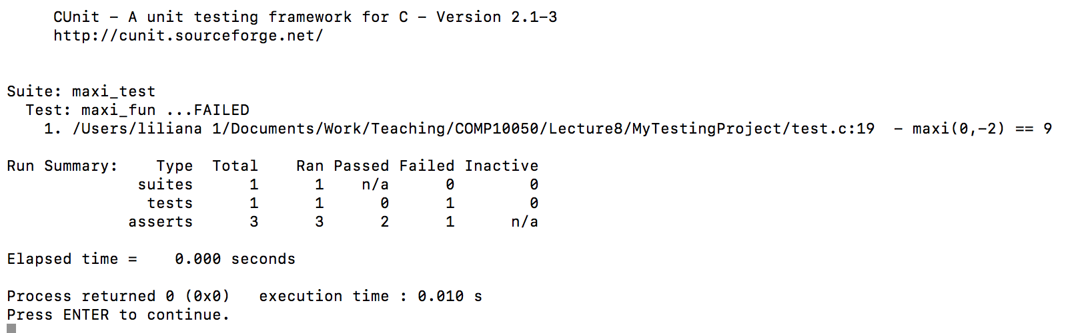
Test Report
Obtained after executing MyTestingProject
Notes:
Normal mode – failures and run summary are printed
Silent mode – no output is printed except framework error messages
Verbose – maximum output of run details

Slide 26
Test Report
Obtained after executing MyTestingProject
Notes:
Normal mode – failures and run summary are printed
Silent mode – no output is printed except framework error messages
Verbose – maximum output of run details

Slide 27
Example 2: triangle.c
char * checkTriangle(int a, int b, int c){
if(a == 90 || b == 90 || c == 90)
return "Right";
if(a == 60 && b == 60 && c == 60)
return "Equilateral";
if(a == b || b == c || c == a)
return "Isosceles";
return "Scalene";
}
Notes:
The output of the architectural design process is an architectural model describing how the system is organised as a set of communicating components

Slide 28
Example 2: test.c
void triangle_testcase1(void){
CU_ASSERT(strcmp("Equilateral", checkTriangle(60,60,60)) == 0);
CU_ASSERT_STRING_EQUAL("Right", checkTriangle(40,90,50));
CU_ASSERT_STRING_NOT_EQUAL("Isosceles", checkTriangle(80,80,50));
}
void runAllTests(){
CU_initialize_registry();
CU_pSuite suite = CU_add_suite("triangle_suite", 0, 0);
CU_add_test(suite, "triangle_test", triangle_testcase1);
CU_basic_set_mode(CU_BRM_VERBOSE);
CU_basic_run_tests();
CU_cleanup_registry();
}
int main() {
runAllTests();
return 0;
}
Notes:
The output of the architectural design process is an architectural model describing how the system is organised as a set of communicating components

Slide 29
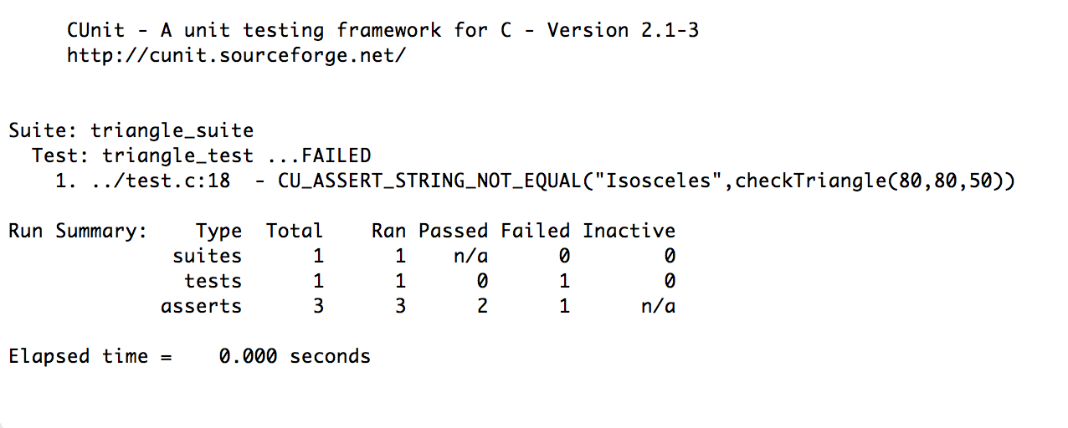
Test Report
Notes:
Normal mode – failures and run summary are printed
Silent mode – no output is printed except framework error messages
Verbose – maximum output of run details

Slide 30
Example 3
// calculate the slope of the line
double getSlope(double x1, double y1, double x2, double y2 ) {
// avoid dividing by zero
if(x1 == x2){
perror("It is impossible to calculate the slope of a vertical line");
return -1;
}
else return (y2 - y1) / (x2 - x1);
}
// calculate the perimeter of the line
double getDistance(double x1, double y1, double x2, double y2) {
return sqrt((x2 - x1) * (x2 - x1) + (y2 - y1) * (y2 - y1));
}
Notes:
The major advantage of relying on other systems for patient information is to avoid duplicating data.
The major disadvantage is that it can slow down information access. If such systems are not available the whole system cannot be used.

Slide 31
Cases
Case 1: the line is horizontal
Case 2: the line is neither horizontal nor vertical
Case 3: the line vertical
Notes:
The major advantage of relying on other systems for patient information is to avoid duplicating data.
The major disadvantage is that it can slow down information access. If such systems are not available the whole system cannot be used.

Slide 32
Cases
Case 1: the line is horizontal
Check that returned slope is 0
Case 2: the line is neither horizontal nor vertical
Case 3: the line vertical
Notes:
The major advantage of relying on other systems for patient information is to avoid duplicating data.
The major disadvantage is that it can slow down information access. If such systems are not available the whole system cannot be used.

Slide 33
Cases
Case 1: the line is horizontal
Check that returned slope is 0
Case 2: the line is neither horizontal nor vertical
Check that returned slope is > 0
Check that returned slope is < 0
Case 3: the line vertical
Check that returned slope is equal to - 1
Notes:
The major advantage of relying on other systems for patient information is to avoid duplicating data.
The major disadvantage is that it can slow down information access. If such systems are not available the whole system cannot be used.

Slide 34
In practice
Case 1: the line is horizontal
Case 2: the line is neither horizontal nor vertical
Case 3: the line vertical
Notes:
The output of the architectural design process is an architectural model describing how the system is organised as a set of communicating components

Slide 35
In practice
Case 1: the line is horizontal
void slopeZero_testcase() {
CU_ASSERT_EQUAL(getSlope(0,5,90,5),0); }
Case 2: the line is neither horizontal nor vertical
Case 3: the line vertical
Notes:
The output of the architectural design process is an architectural model describing how the system is organised as a set of communicating components

Slide 36
In practice
Case 1: the line is horizontal
void slopeZero_testcase() {
CU_ASSERT_EQUAL(getSlope(0,5,90,5),0); }
Case 2: the line is neither horizontal nor vertical
void slopeMiddle_testcase() {
CU_ASSERT(getSlope(0,0,90,54) > 0);
CU_ASSERT(getSlope(0,90,4,54) < 0); }
Case 3: the line vertical
Notes:
The output of the architectural design process is an architectural model describing how the system is organised as a set of communicating components

Slide 37
In practice
Case 1: the line is horizontal
void slopeZero_testcase() {
CU_ASSERT_EQUAL(getSlope(0,5,90,5),0); }
Case 2: the line is neither horizontal nor vertical
void slopeMiddle_testcase() {
CU_ASSERT(getSlope(0,0,90,54) > 0);
CU_ASSERT(getSlope(0,90,4,54) < 0); }
Case 3: the line vertical
void slopeError_testcase() {
CU_ASSERT(getSlope(0,90,0,54) == -1); }
Notes:
The output of the architectural design process is an architectural model describing how the system is organised as a set of communicating components

Slide 38
How to run the test cases
void runAllTests(){
CU_initialize_registry();
CU_pSuite suite = CU_add_suite("slope_suite", 0, 0);
CU_add_test(suite, "slopeZero_test", slopeZero_testcase);
CU_add_test(suite, "slopeMiddle_test", slopeMiddle_testcase);
CU_add_test(suite, "slopeError_test", slopeError_testcase);
CU_basic_set_mode(CU_BRM_VERBOSE);
CU_basic_run_tests();
CU_cleanup_registry(); }
int main() {
runAllTests();
return 0; }
Notes:
The major advantage of relying on other systems for patient information is to avoid duplicating data.
The major disadvantage is that it can slow down information access. If such systems are not available the whole system cannot be used.

Slide 39
How to run the test cases
void runAllTests(){
CU_initialize_registry();
CU_pSuite suite = CU_add_suite("slope_suite", 0, 0);
CU_add_test(suite, "slopeZero_test", slopeZero_testcase);
CU_add_test(suite, "slopeMiddle_test", slopeMiddle_testcase);
CU_add_test(suite, "slopeError_test", slopeError_testcase);
CU_basic_set_mode(CU_BRM_VERBOSE);
CU_basic_run_tests();
CU_cleanup_registry(); }
int main() {
runAllTests();
return 0; }
Notes:
The major advantage of relying on other systems for patient information is to avoid duplicating data.
The major disadvantage is that it can slow down information access. If such systems are not available the whole system cannot be used.

Slide 40
How to run the test cases
void runAllTests(){
CU_initialize_registry();
CU_pSuite suite = CU_add_suite("slope_suite", 0, 0);
CU_add_test(suite, "slopeZero_test", slopeZero_testcase);
CU_add_test(suite, "slopeMiddle_test", slopeMiddle_testcase);
CU_add_test(suite, "slopeError_test", slopeError_testcase);
CU_basic_set_mode(CU_BRM_VERBOSE);
CU_basic_run_tests();
CU_cleanup_registry(); }
int main() {
runAllTests();
return 0; }
Notes:
The major advantage of relying on other systems for patient information is to avoid duplicating data.
The major disadvantage is that it can slow down information access. If such systems are not available the whole system cannot be used.

Slide 41
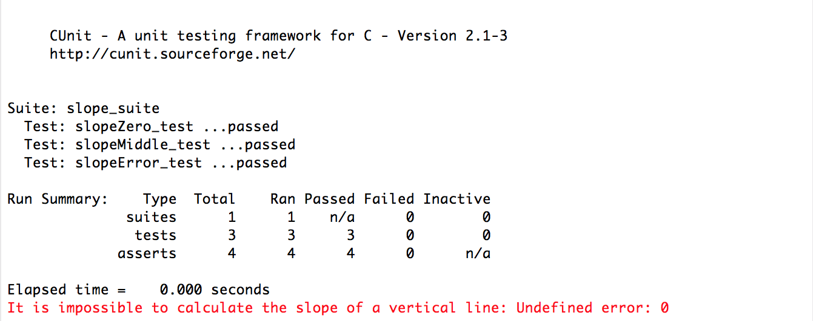
Test Report
Notes:
Normal mode – failures and run summary are printed
Silent mode – no output is printed except framework error messages
Verbose – maximum output of run details

Slide 42
Conclusion
Code that isn’t tested doesn’t work
Code that isn’t regression tested breaks eventually
A unit testing framework enables efficient and effective unit and regression testing
Use CUnit to store and maintain all the small tests that you write anyway
Write tests instead of playing with printf is better because tests can be repeated automatically
Notes:
The output of the architectural design process is an architectural model describing how the system is organised as a set of communicating components

